Slide 1
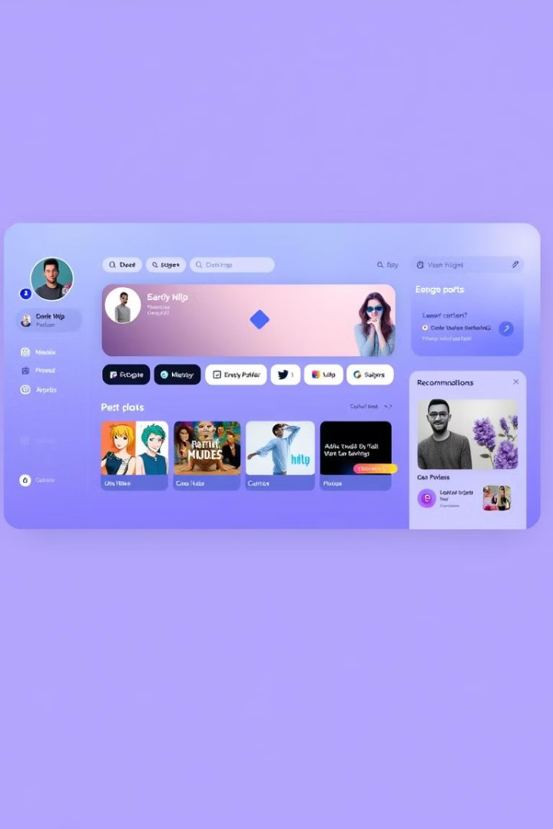
LioCinema-Jotstar OTT Platform Analysis
Comprehensive Market Insights (January-November 2024)
Notes:
Good morning, everyone. Today, I'm presenting a comprehensive analysis of our digital entertainment platform merger - a project born out of the Codebasics Resume Project Challenge 14. This isn't just a data exercise; it's a strategic deep dive into the transformative journey of LioCinema and Jotstar.
This challenge pushed me to go beyond surface-level analysis, transforming raw data into strategic insights that can drive our business forward. What you'll see today is a meticulous examination of our platform's performance from January to November 2024.

Slide 2

Executive Summary
1
Total Users
228,000 (+22.1% Growth) demonstrate platform appeal.
2
Active Users
139,000 (61%) signal robust engagement.
3
Paid Users
111,000 (+21.2% Growth) drive revenue growth.
4
Total Revenue
$12.58 Million (+17.9% Growth) shows financial success.
Notes:
Let's cut to the chase - our numbers are compelling. We've achieved:
228,000 total users with an impressive 22.1% growth
139,000 actively engaged users
111,000 paid subscribers and
$12.58 Million in total revenue
These aren't just statistics. The Codebasics challenge taught me to look beyond numbers and see the story they tell.

Slide 3
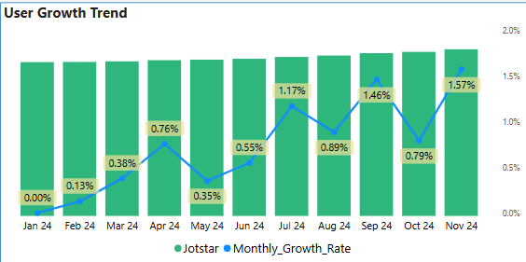
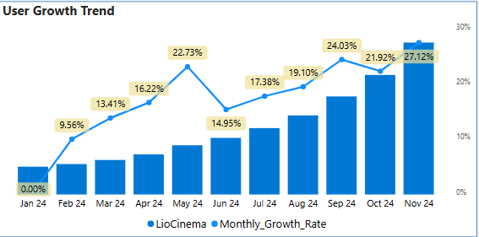
User Growth Trends
Jotstar Peak Growth
LioCinema Peak Growth
Growth Trajectory
3.20% in January shows initial market positioning
21.62% in November highlights content strategy and scaling potential.
Consistent upward movement for Lio Cinema, steady performance for Jotstar.
Notes:
Let's dive into our user growth trends, which tell a story of our platform's evolution.
Jotstar's Journey:
Starts with a modest 3.00% growth in January
Experiences fluctuating growth rates throughout the year
Peaks at around 14% in some months
Maintains a generally positive growth trajectory
LioCinema's Progression:
Begins with a 3.56% growth in January
Shows more consistent and steady growth
Reaches peak growth of around 21.62% in November
Demonstrates a more linear upward growth pattern
Key Insights:
Both platforms show resilient growth despite market challenges
LioCinema displays more consistent month-over-month growth
Jotstar shows more variability but maintains an upward trend

Slide 4
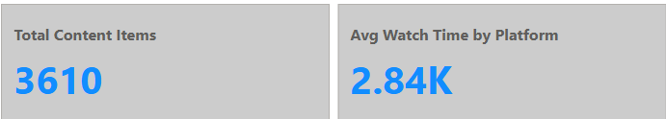
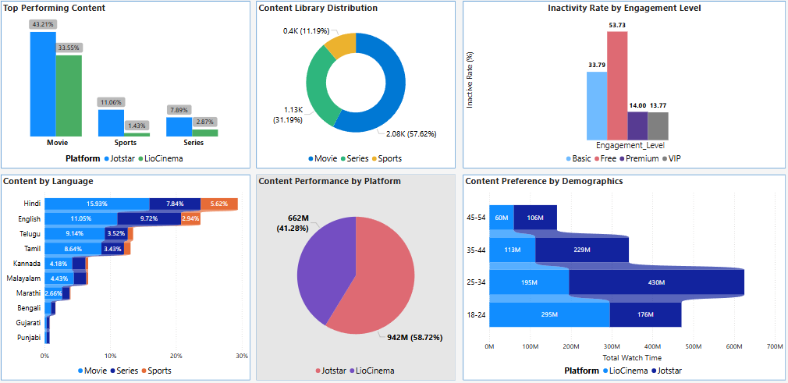
Content Library Breakdown
Total Content Items: 3,610
Movies: 43% (Jotstar) | 34% (LioCinema)
Sports: 11% (Jotstar) | 1.4% (LioCinema)
Series: 8% (Jotstar) | 3% (LioCinema)
Movies dominate content for both. Sports has higher preference for Jotstar. Series needs more expansion.
Notes:
Content is our primary differentiator. We have 3,610 total content items, each strategically positioned:
Movies dominate: Jotstar at 43%, LioCinema at 34%
Sports is an interesting segment: Jotstar leads with 11%, LioCinema at 1.4%
Series represent our growth opportunity: Jotstar at 8%, LioCinema at 3%

Slide 5
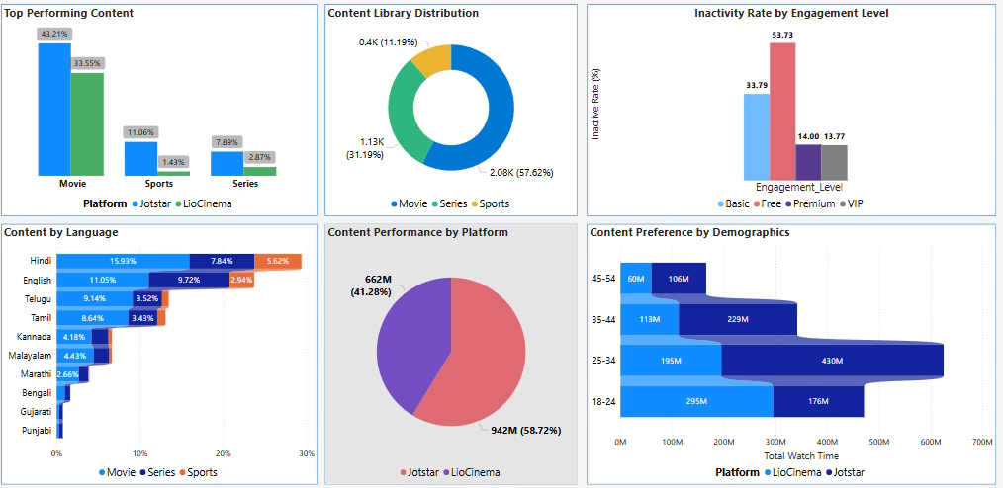

Slide 6

User Demographics
City Tier
Jotstar
LioCinema
Tier 1
38.29%
61.71%
Tier 2
17.37%
82.63%
Tier 3
6.81%
93.19%
Jotstar's audience is concentrated in Tier 1 cities. LioCinema has a broader reach across tiers.
Notes:
Our geographical reach is our strength. Look at our city tier distribution:
Jotstar is primarily urban, with 38% in Tier 1 cities
LioCinema has a phenomenal reach: 61.71% in Tier 1, 82.63% in Tier 2, and an incredible 93.19% in Tier 3 cities

Slide 7
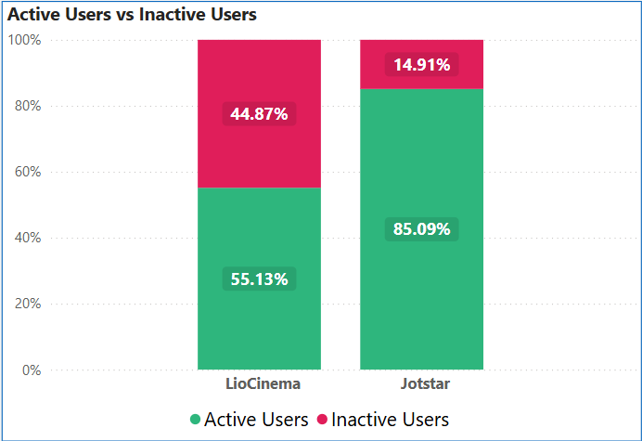
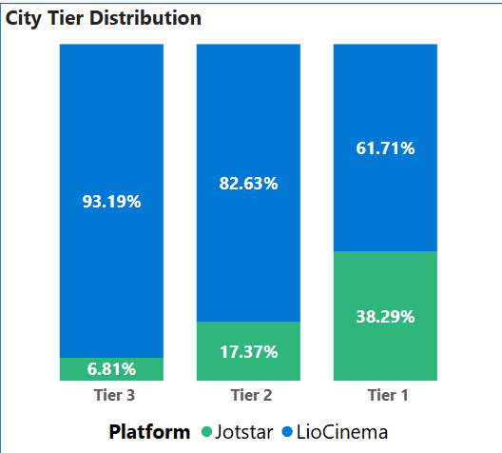

Slide 8




User Engagement
Jotstar
LioCinema
Free Plan
85.09% Active Users signifies high loyalty.
55.13% Active Users shows engagement opportunity.
53.73% Inactive users pose conversion challenge.
Notes:
Engagement is the heartbeat of our platform. Jotstar boasts an 85.09% active user rate - a testament to its content and user experience. LioCinema sits at 55.13%, which I see not as a weakness, but as an enormous opportunity.
Our most significant challenge? Free plan users. 53.73% are currently inactive. But through the Codebasics challenge, I've learned to see this not as a problem, but as a massive conversion opportunity.

Slide 9
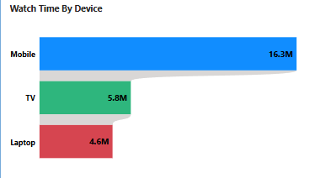
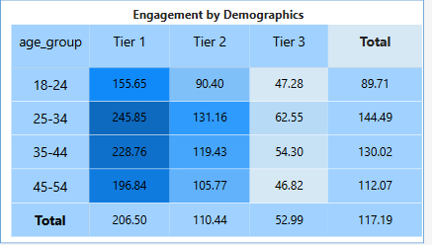
Watch Time Analysis
Total watch time reached 26.73 Million Hours. Mobile devices are the primary viewing platform.
Notes:
We've accumulated 26.73 Million watch hours - a number that speaks volumes:
Mobile dominates with 16.3 Million hours
TV contributes 5.8 Million hours
Laptops add 4.6 Million hours
This tells us our users want entertainment on their terms. Mobile isn't just a platform; it's our primary connection with our audience.

Slide 10
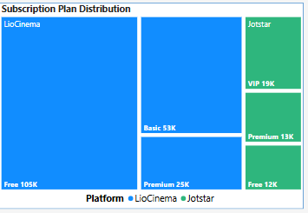
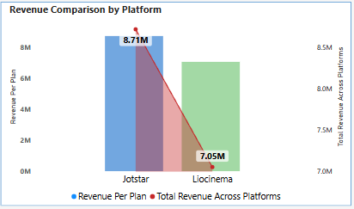
Subscription & Revenue
LioCinema
Jotstar
Free: 105K, Basic: 53K, Premium: 25K, VIP: 19K
Free: 12K, Premium: 13K, VIP: 19K
Total Revenue: $12.58M (Jotstar: $8.71M, LioCinema: $7.05M). Revenue is strong. Conversion needs work.
Notes:
Let's talk financials. Our subscription model reveals fascinating insights:
LioCinema's breakdown:
Free: 105,000 users
Basic: 53,000 users
Premium: 25,000 users
VIP: 19,000 users
Jotstar's model:
Free: 12,000 users
Premium: 13,000 users
VIP: 19,000 users
Total revenue: $12.58 Million
Jotstar contribution: $8.71 Million
LioCinema contribution: $7.05 Million
These aren't just numbers. They're a testament to our value proposition and user trust

Slide 11
Inactivity Correlation Analysis
Low Watch Time
Moderate Watch Time
High Watch Time
Users with less than 2 hours monthly watch time have a 61% higher chance of becoming inactive.
Users watching 2-5 hours monthly show a 39% inactivity rate.
Only 16% of users are inactive with over 5 hours of monthly watch time.
Notes:
Our strategic roadmap focuses on three key areas:
User Engagement: Converting free and basic users through targeted retention programs.
Content Strategy: Expanding content diversity, particularly in sports and series.
Technological Innovation: Enhancing mobile and TV experiences with AI-driven recommendations.
The Codebasics challenge taught me that recommendations must be data-driven and forward-looking.

Slide 12
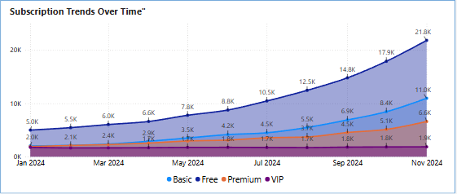
Engagement by Subscription Plan
Free Plan
Basic Plan
1.1 hours/month watch time. 52% inactivity.
3.2 hours/month watch time. 32% inactivity.
Premium Plan
8.4 hours/month watch time. 12% inactivity.
Notes:
Our future is about strategic expansion:
Target Markets: Tier 2 and Tier 3 cities
Demographic Focus: 25-44 age group
Platform Improvement Priorities: User acquisition, content diversity, engagement metrics, and revenue per user
We're not just building a platform. We're creating a comprehensive digital entertainment ecosystem.
Closing Remarks: This project, born from the Codebasics Resume Project Challenge 14, is more than an analysis. It's a blueprint for our digital future

Slide 13
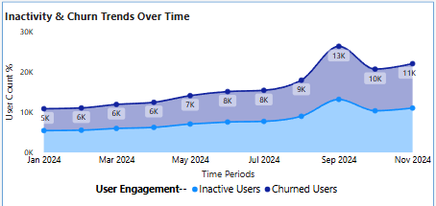
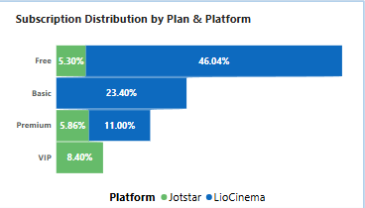

Slide 14
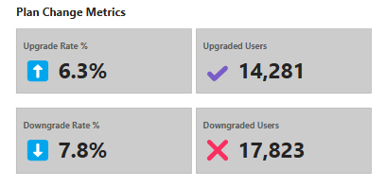


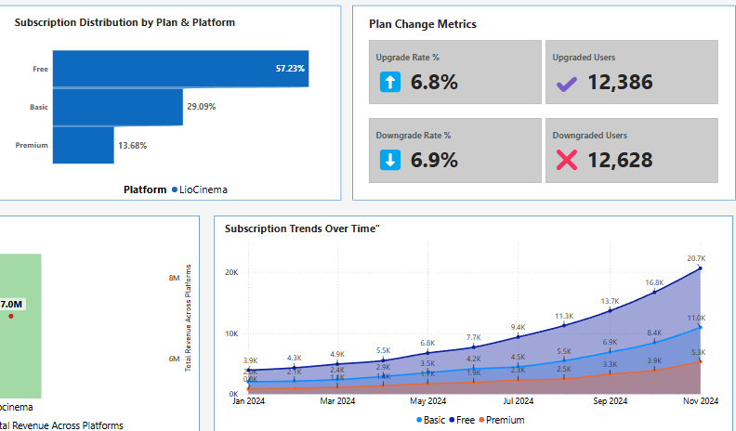
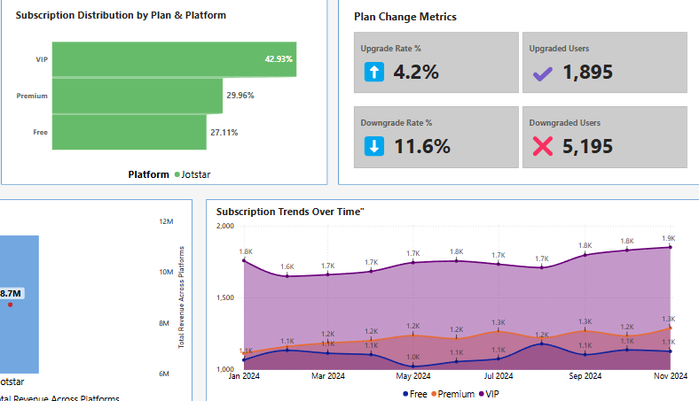
Subscription Transition Dynamics
Downgrade Trends
Total downgrades: 17823 users.
LioCinema Downgrades: 12,628 users
Jotstar Downgrades: 5,195 users
Upgrade Trends
Total upgrades: 14281 users.
LioCinema Upgrades: 12,386 users
Jotstar Upgrades: 1,895 users

Slide 15




Strategic Recommendations
User Engagement
Convert free/basic users. Develop retention programs.
Content Strategy
Expand content diversity. Strengthen sports and series.
Technological Innovation
Enhance mobile/TV experiences. AI recommendations.

Slide 16

Future Outlook
Target Markets
Demographic Focus
Expand into Tier 2 & Tier 3 cities.
Engage 25-44 age group.
Platform Improvement
Boost mobile & TV engagement.
Prioritize user acquisition rate, content diversity, engagement metrics, revenue per user. These are critical.

